Slide 1
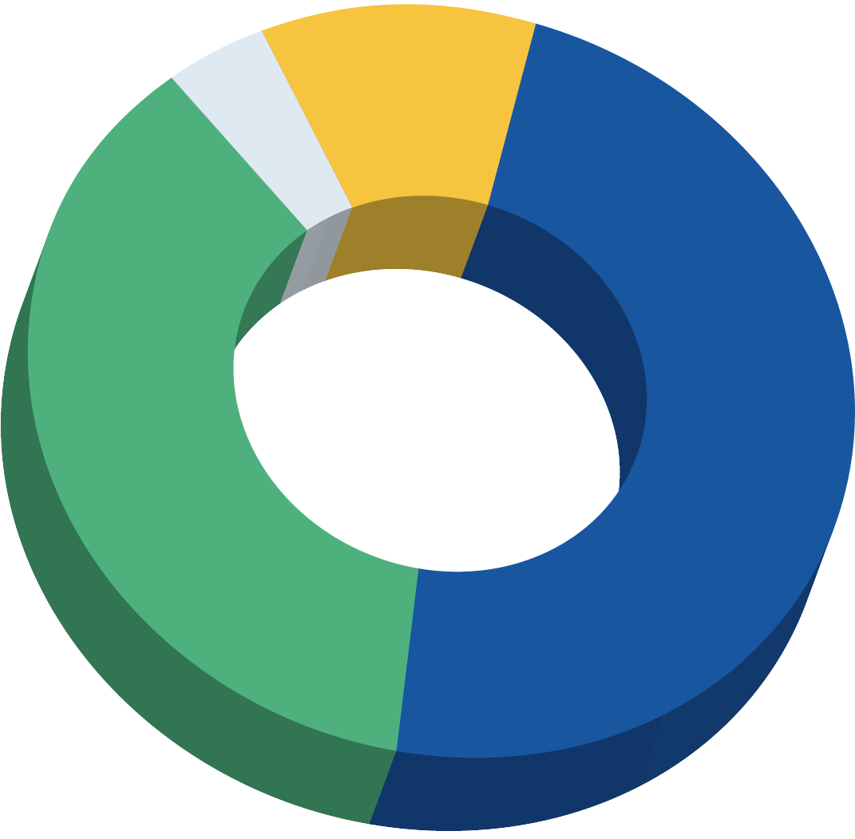
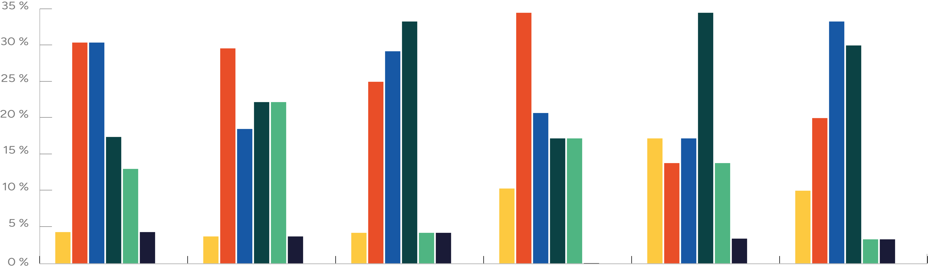
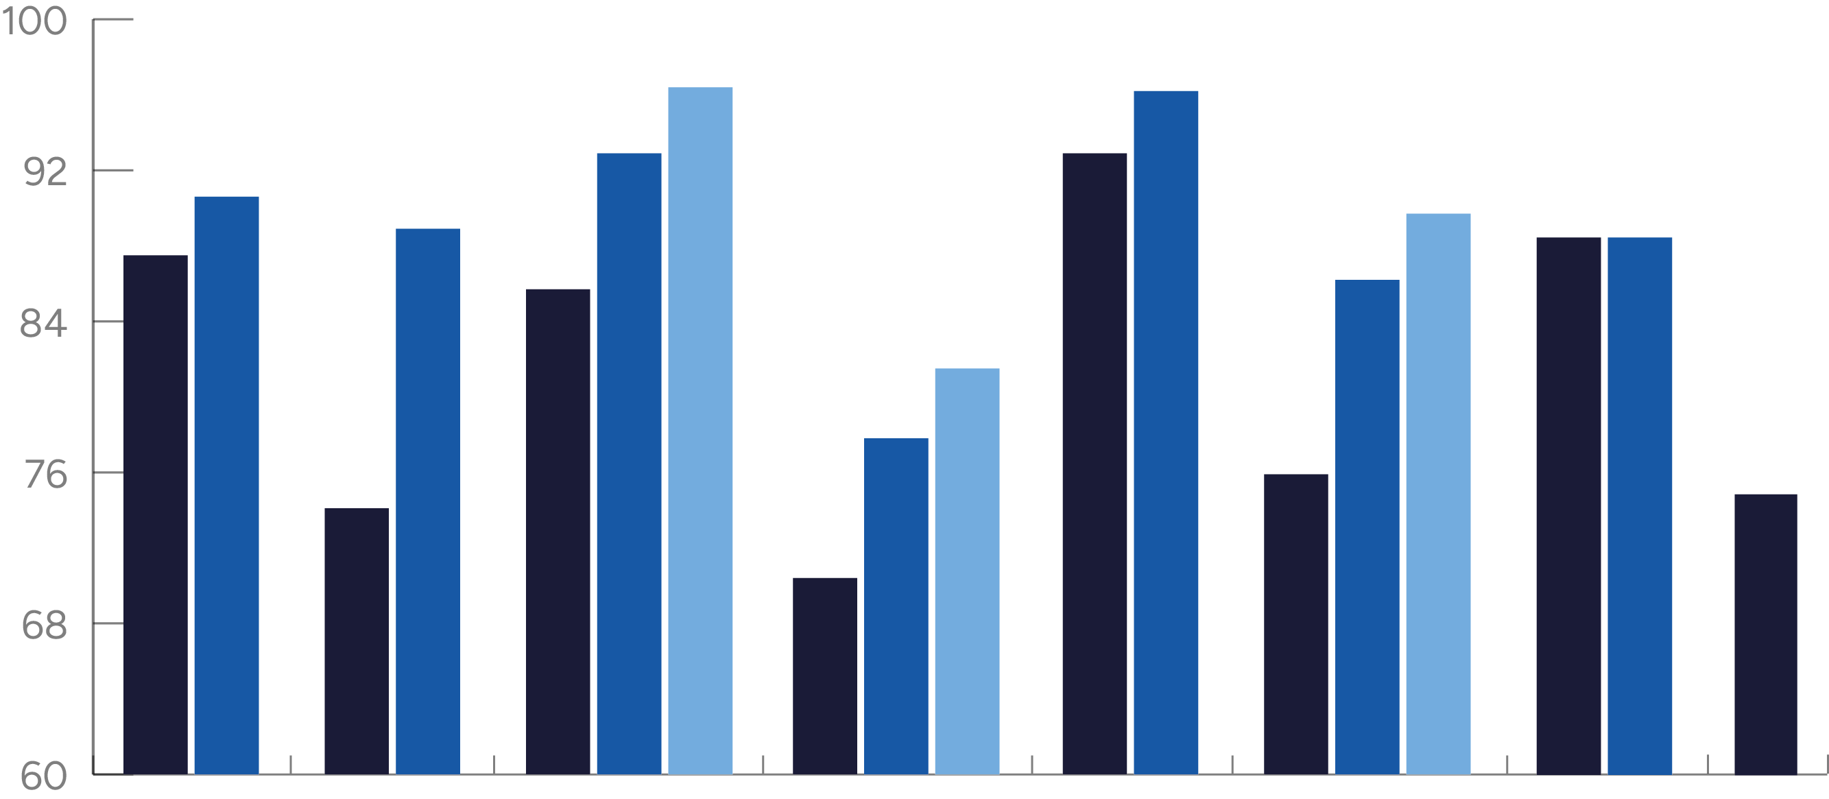
Dashboard development for the International pharmacy bridging program (QeP)
Isabelle Boisclair, B. Pharm., M. Sc.¹, Joannah Valma, M. Sc¹, Nathalie Dubois¹ Ph. D., Gilles Leclerc¹, Ph. D., B.Pharm.,
Nathalie Letarte^{1,2}, Pharm. D., M. Sc., DESG, BCOP
¹Faculty of pharmacy – Université de Montréal, ²Centre hospitalier de l’Université de Montréal (CHUM)
Background
Following a major redesign in 2021, the pharmacy bridging program for International graduates (Qualification en Pharmacie - QeP) welcomed its
14th cohort at the end of August 2024¹.
A dashboard has been developed, jointly with the Evaluation Office (BEAC) to monitor key indicators following program restructuring.
Goals and Method
This poster aims to present the QeP dashboard development process and to analyze the challenges encountered as well as the organizational learning opportunities generated. In particular, we aim to:
Document the collaborative process of developing relevant indicators
Analyze challenges related to data collection and interpretation
Examine how the dashboard can be used for continuous improvement
Explore how it can reduce the cognitive overload of decision-makers.
The evaluation is based on the analysis of resources invested, the relevance of the performance model, the quality of indicators and the appreciation of the program team.
Description
The dashboard was developed using a five-stage iterative and participative approach:
Needs Definition: Workshops with program staff, management and faculty identified priority evaluation questions.
Identification of key Indicators: Indicators were organized into four pillars.
Validation of data quality: A review of institutional data sources revealed the need for additional data collection tools.
Design of presentation structure : A dynamic interface was created.
Definition of objectives: The next step is to define relevant target values based on historical data and strategic objectives and validate them
with end-users.
The Dashboard
The second edition of the dashboard is structured into coherent and clearly illustrated sections, providing a comprehensive and systematic overview of the QeP. The dashboard also makes it possible to compare data from
pre-restructuring (2015 to 2020) and post-restructuring (2021 to present) periods.
Pillars:
Student Profile | Program Governance and Development | Learning
Experience | Academic Success | Professional and Academic Transition
New Enrollees by Age group
Fall 2024
Distribution of registrants based on the number of years elapsed between obtaining the Pharm degree and the QeP | Fall 2019 to 2024
Graduation Rate – New Enrollees
4 %
30,4
33,3
34,5
34,5
33,3
96,4
96,2
11 %
30,4
29,6
29,2
30,0
90,6
92,9
92,9
88,9
89,7
88,5
25,0
66,7 %
69,0 %
90,0 %
87,5
85,7
86,2
88,5
30,4
73,1 %
47,8 %
60,0 %
76,0 %
76,7 %
18,5
30,4
20,7
20,0
81,5
17,4
17,2
17,2
37 %
48 %
17,2
17,2
13,8
77,8
75,9
75,0
13,0
10,3
13,8
74,1
26,9 %
33,3 %
46,4 %
52,2 %
40,0 %
24,0 %
23,3 %
10,0
31,0 %
70,4
4,3
4,3
4,2
4,2
3,7
3,7
4,2
3,3
0,0
3,4
3,3
0,0
0,0
0,0
0,0
0,0
0,0
20 to 29 years old
30 to 39 years old
40 to 49 years old
50 to 59 years old
Fall 2019
Fall 2020
Fall 2021
Fall 2022
Fall 2023
Fall 2024
2015
2016
2017
2018
2019
2020
2021
2022
< 5 years
5-9 years
10-14 years
15-19 years
20-24 years
25-29 years
30-34 years
% Graduates after 2 years
% Graduates after 3 years
% Graduates after 4 years
Discussion
Developing and implementing the QeP dashboard has created valuable organizational learning, supporting Cagnazzo et al. (2010) theory that performance measurement systems drive organizational learning.
Main challenges
Combining data from different information systems
Ongoing investment (e.g. measurements, adaptation of strategic
plan) is required to keep the tool up to date
Difficult to set achievable targets
Striking a balance between comprehensive information and simple display
For the next edition, the team plans to integrate data on the preparatory program and develop new indicators regarding student career paths and the requirements of the Ordre des Pharmaciens du Québec.
Our dashboard experience has taught us some important organizational lessons :
Teamwork is important : Developing the dashboard required continuous effort and active collaboration. Working together helped everyone adopt the tool, although it required careful coordination at all levels.
Methodology expertise: Creating good indicators is challenging and must take account of institutional realities.
Data limitations: Existing information systems cover only some necessary indicators, requiring additional data collection.
Decision-making value: Tracking program data has proved highly useful for making evidence-based decisions. Clear and timely disclosure of results to stakeholders is essential.
Goal setting : This step requires in-depth knowledge of the program and ongoing commitment from the team.
Conclusion
This approach contributes to a broader transformation where evaluation generates new knowledge and fosters continuous improvement across all Faculty programs. By using this tool regularly, the team will be able empowered to track program progress, validate redesign objectives and identify priorities for continuous improvement.
References
Leclerc G, Boisclair I, Lafleur I, Minville A, Ferreira E. Université de Montréal international pharmacy bridging program: A program evaluation process. Poster PE14 at CPERC in May 2020, Montréal. QC.
Cagnazzo, L., Taticchi, P. et Brun, A. (2010). The role of performance measurement systems to support quality improvement initiatives at supply chain level. International Journal of Productivity and Performance Management, 59(2), 163-185.
Secundo, G., Margherita, A., Elia, G. et Passiante, G. (2010). Intangible assets in higher education and
research: mission, performance or both? Journal of Intellectual Capital, 11(2), 140-157.
Silvi, R., Bartolini, M., Raffoni, A. et Visani, F. (2015). The practice of strategic performance measurement systems. International Journal of Productivity and Performance Management, 64(2), 194-227.
Notes:
20-24
Between 10-14 years

